Slide 1

YOU’RE
ON MUTE!
A Device to Control M$ Teams

Slide 2
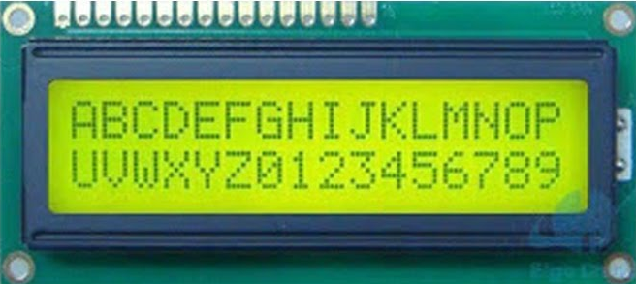



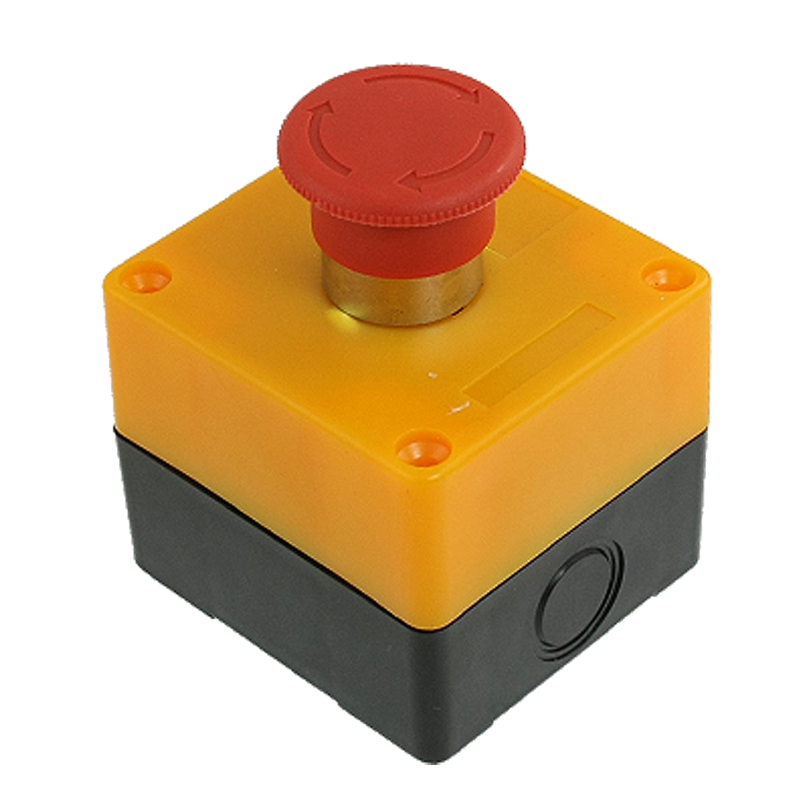
Components of the Solution
101010010101
Cycle
Windows
Toggle
Mute
Toggle
Camera
External
Wireless
PC software to
hardware
protocol
control teams

Slide 3
Hardware - Schematic

Slide 4
Hardware - Reality

Slide 5
Explanation of circuit? Explanation of software compilation and upload?

Slide 6
Protocol

Slide 7
PC Software

Slide 8
Demo

Slide 9
Bill of Sale
Wired
USB
Wireless
Bluetooth
Component | Quantity | Total
Component | Quantity | Total

Slide 10
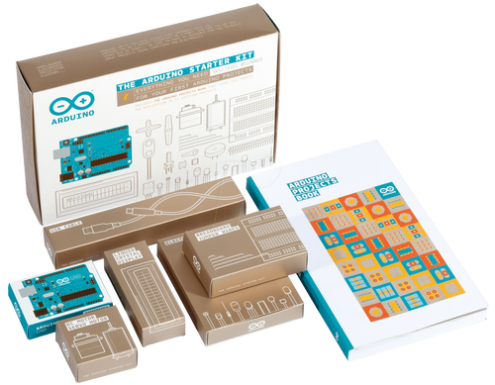
Try Yourself?
The
Arduino
Starter
Kit

